Slide 1
To find the Square Root of a Complex Number
Dr. Aruna Kulkarni

Slide 2
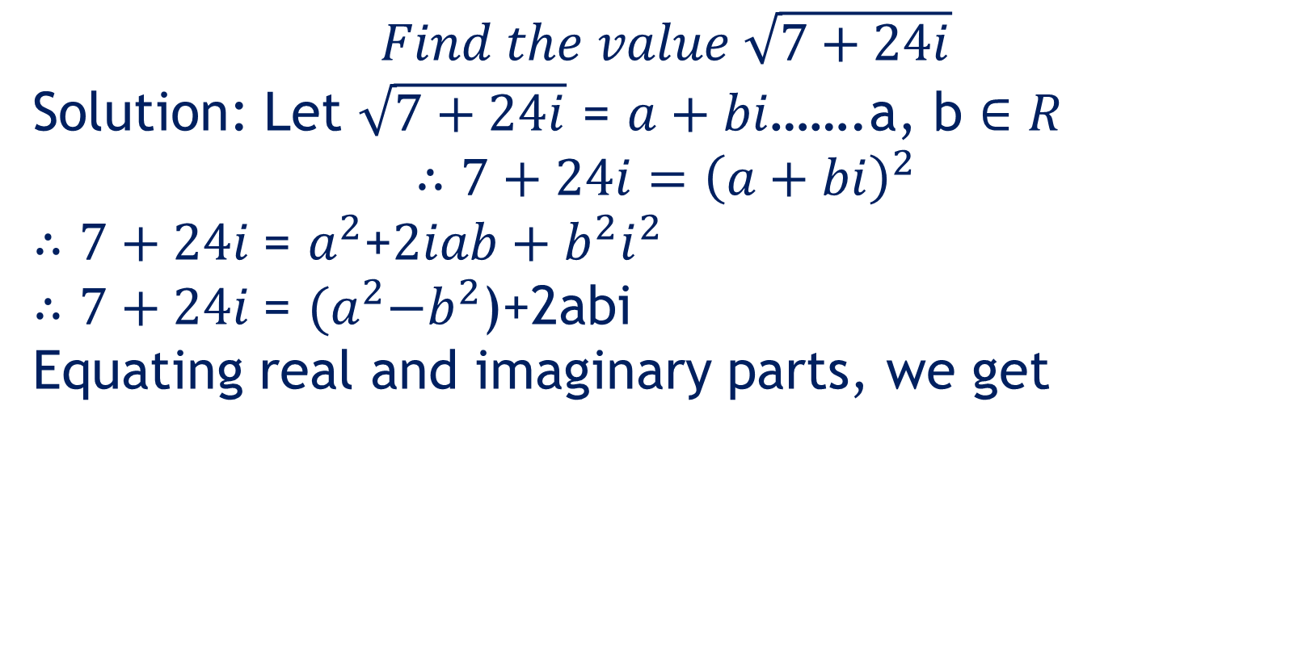
$$Find the value \sqrt{7+24i}$$
Solution: Let $\sqrt{7+24i}$ = $a+bi$…….a, b $∈R$
$$∴7+24i={\left(a+bi\right)}^{2}$$
$∴7+24i$= $a^{2}$+$2iab+b^{2}i^{2}$
$∴7+24i$= ${(a}^{2}−b^{2}$)+2abi
Equating real and imaginary parts, we get

Slide 3

${(a}^{2}−b^{2}$)= 7 ……….. .. I
and
2ab = 24……………………. II
$∴$b= 24/2a=12/a
$∴a^{2}−{\left(\frac{12}{a}\right)}^{2}$=7……..from I
$∴a^{2}−\frac{144}{a^{2}}$=7
$\frac{a^{4}−144}{a^{2}}$ = 7
$$a^{4}−144=7a^{2}$$

Slide 4

$$∴a^{4}−7a^{2}−144=0$$
$∴$($a^{2}{−16)(a}^{2}+9)=0$
$∴$($a^{2}{−16)=0 or(a}^{2}+9)=0$
$$∴a^{2}{=16 or a}^{2}=−9$$
$but a^{2}≠−9$ as a$∈R$
$∴a^{2}$=16
$$∴a=±4$$

Slide 5

When a= 4, b=$\frac{12}{4}$ =3
a= -4, b=$\frac{12}{−4}$= -3
$$∴\sqrt{7+24i}=±\left(4+3i\right)$$
Thank You

